Slide 1
Real time web programming using SignalR Rimas Šaltis 2012-10-16

Slide 2

demo what made me so exited?

Slide 3
agenda
why real-time & how
what is SignalR?
programming: persistent connections & hubs
hosting SignalR outside ASP.NET
unit testing SignalR

Slide 4
real-time communication problems in web
1st and last problem is HTTP. Why?
web is request - response
web is stateless

Slide 5
websockets to the rescue
extension html5
full duplex communication channel
works with proxies
not every browser supports it
not every web server supports it
not every proxy supports it
raw sockets

Slide 6
periodic pooling
Server
Client
pooling interval
delay on real time data
decreasing pooling interval wastes bandwidth and server resources

Slide 7
long pooling
Server
Server
Client
Client

Slide 8
forever frame
Server
Client
HTTP/1.1 200 OK
Content-Type: text/plain
Transfer-Encoding: chunked
<script>eval(“...”)<script/>\0
<script>eval(“...”)<script/>\0

Slide 9

web sockets forever frame long pooling interval pooling too many options!

Slide 10
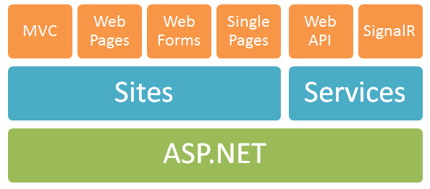
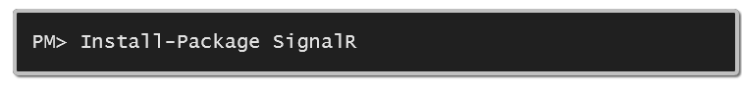
what is SignalR?
created by David Fowler & Damian Edwards
open source on GitHub
provides client ↔ server communication protocol
choose optimal transport option
depends on .net 4+ and jQuery
easy to setup with nuget:

Slide 11
clients
…. ….
jQuery
.NET
windows phone
iOS
ASP.NET
Self
OWIN
sql
redis
hosts
backplanes
for
scaling out
rabbitMQ
service bus

